Slide 1
Other Minimum Spanning Tree Applications
23 May. 2025

Slide 2
Min Max Path

Slide 3
Min Max Path Problem
Given a graph, find a path from a source to a target such that the maximum edge weight along the path is minimized.
Example:
Crossing muddy terrain without stepping into deep mud.
Building a road through mountains — minimize the steepest segment.

Slide 4
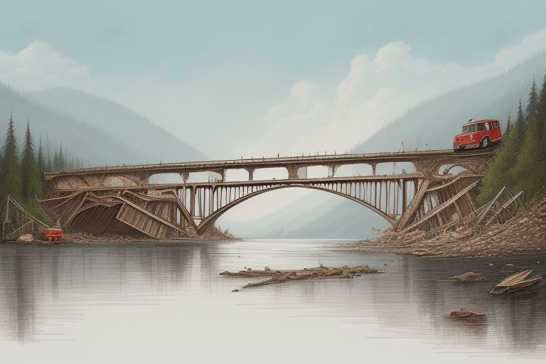
Truck Driver Example
You have a heavy truck, and you want to deliver your goods to the city crossing bridges safely.

Slide 5
Min Max Approach
Minimum Spanning Tree.
Overkill – my personal opinion. We need to build MST and then run BFS and DFS to find minimum of maximum.
Complexity is the same like for Dijkstra.
The amount of code - way more.
Dijkstra algorithm.

Slide 6
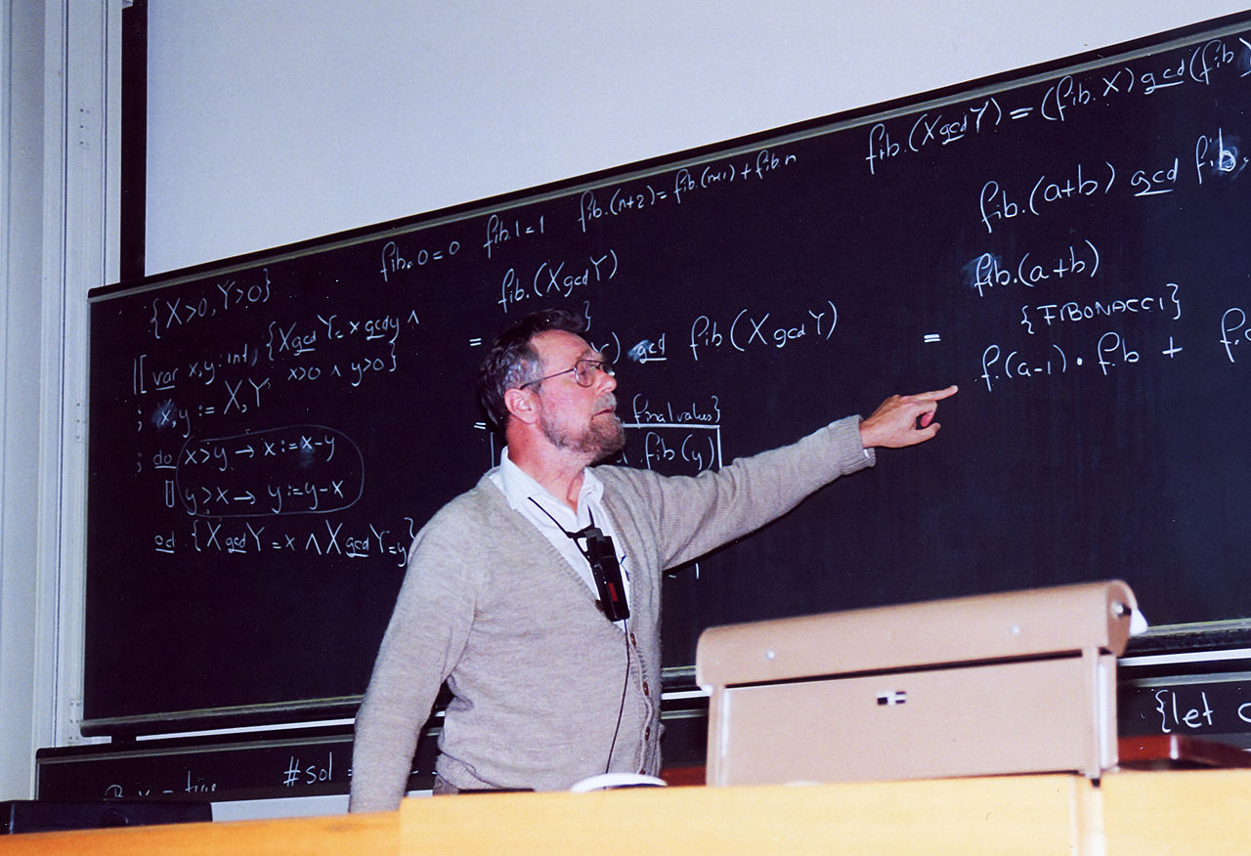
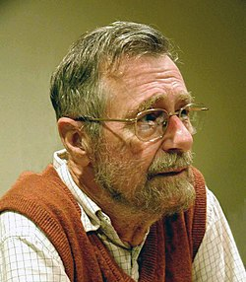
Dijkstra Algorithm
The algorithm help to find the shortest path from a specific node to all other nodes in a graph.

Slide 7
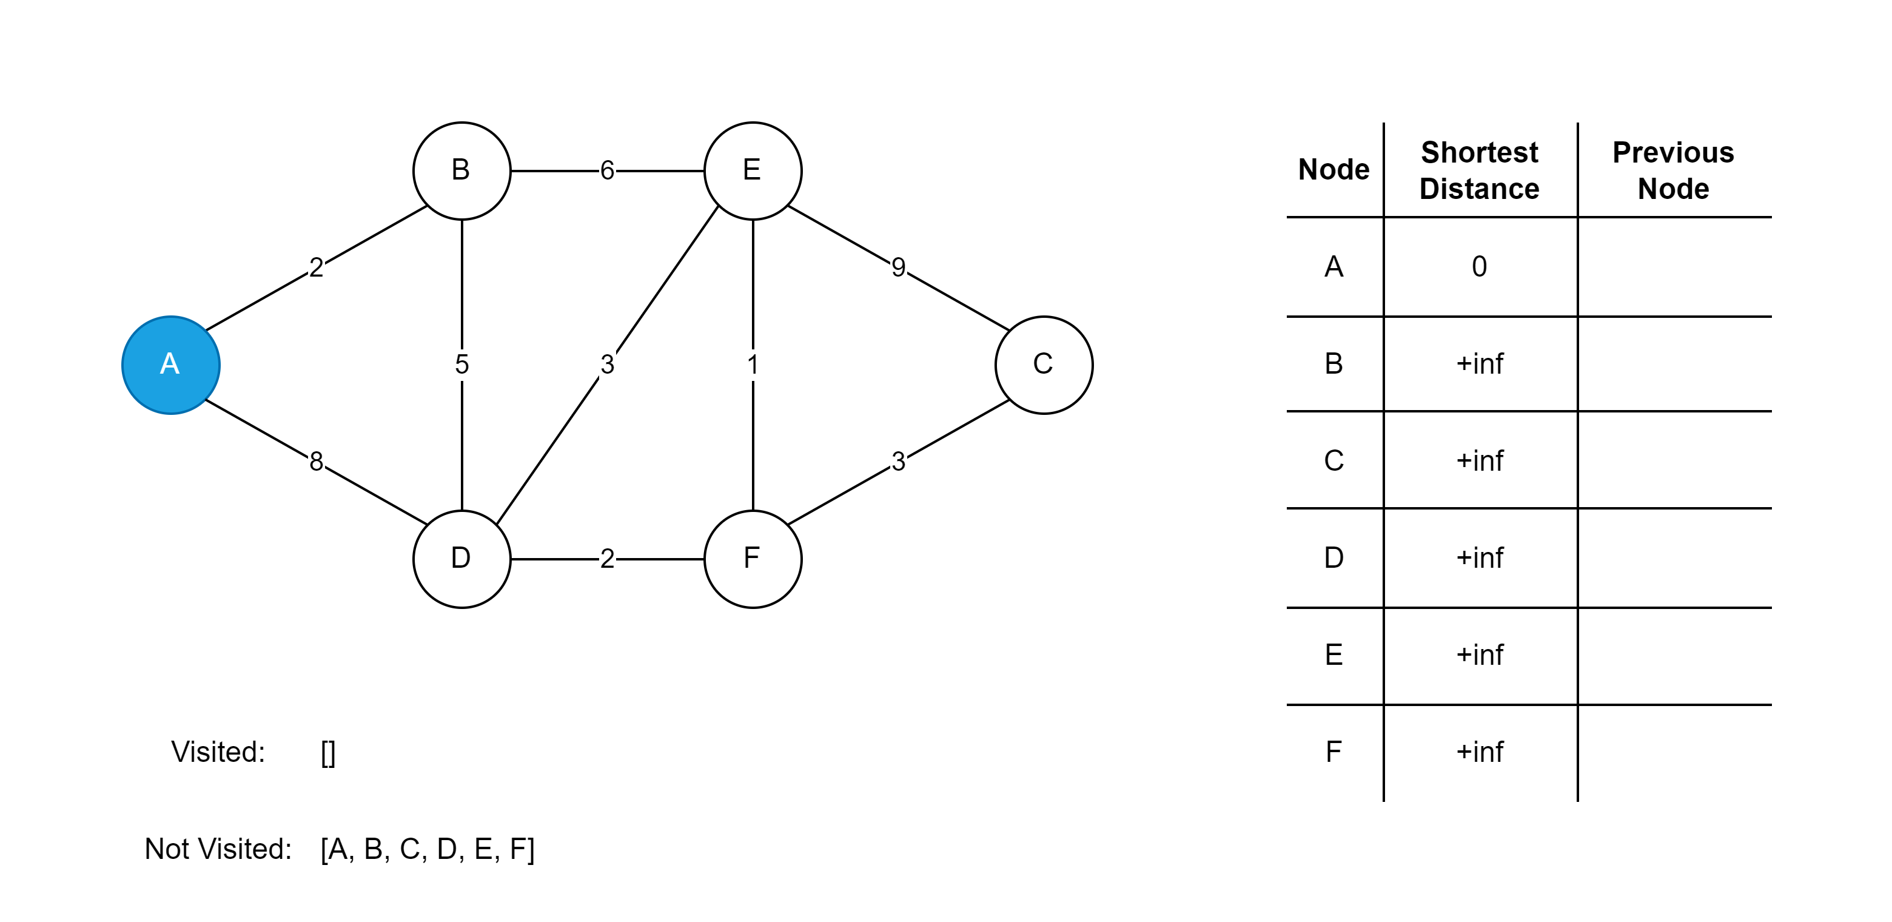
Dijkstra Algorithm – How it Works I

Slide 8
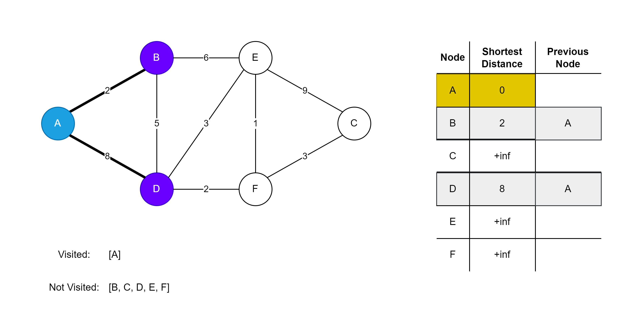
Dijkstra Algorithm – How it Works II

Slide 9
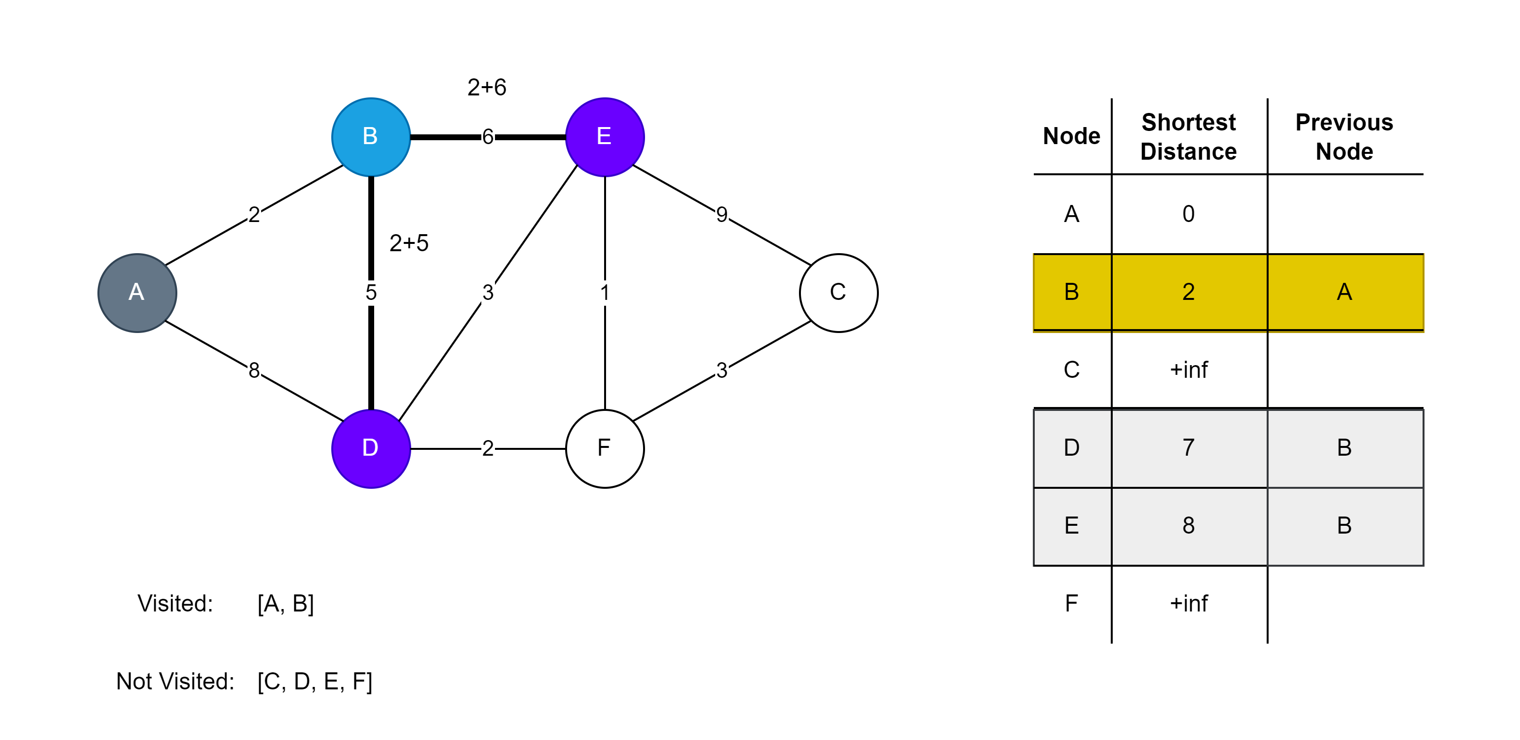

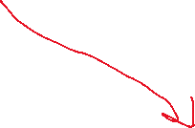



Dijkstra Algorithm – How it Works III

Slide 10
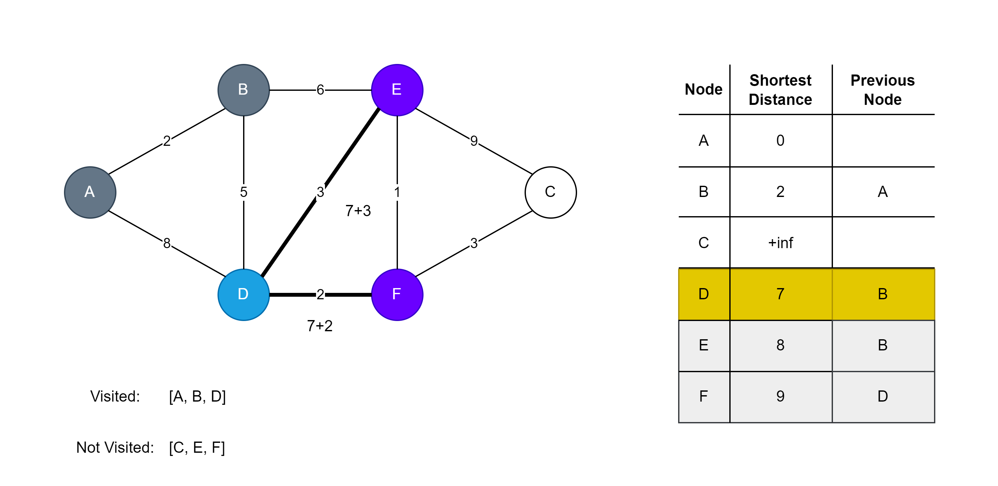
Dijkstra Algorithm – How it Works IV

Slide 11
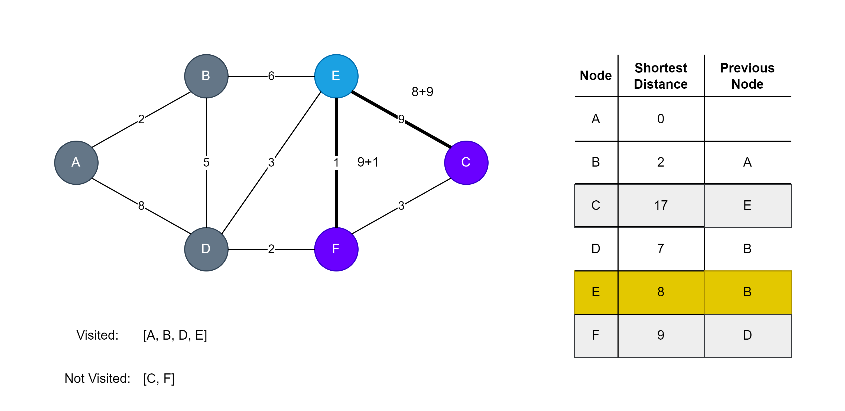
Dijkstra Algorithm – How it Works V

Slide 12
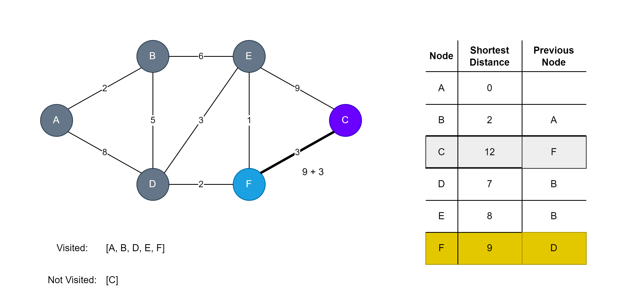
Dijkstra Algorithm – How it Works VI

Slide 13
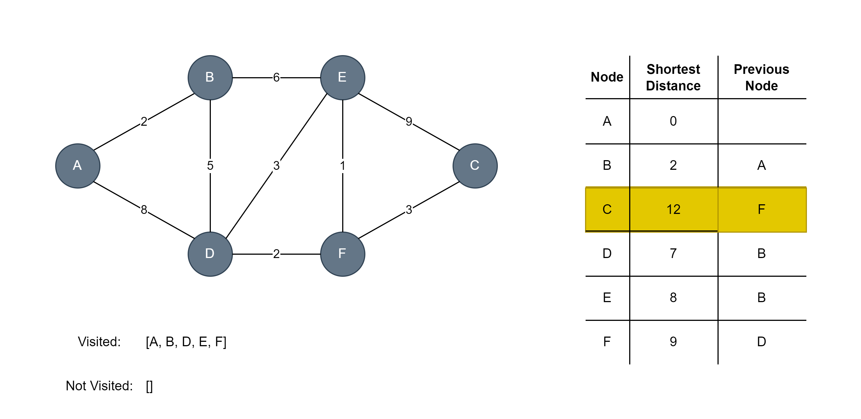
Dijkstra Algorithm – How it Works VII

Slide 14

Min Max Path – Millionaire Madness
Task. Kattis – Link.
Read the task.

Slide 15
Min Max Path – Millionaire Madness
Task. Kattis – Link.
Edge cost is difference between A and B which defines ladder length.
Dijkstra algorithm:
Do not count minimum path.
Use max operation to find the smallest ladder.

Slide 16
Min Max Path – Maddy Hike
Task. Kattis – Maddy Hike – Link.
The same approach.

Slide 17
Minimum Spanning Forest

Slide 18
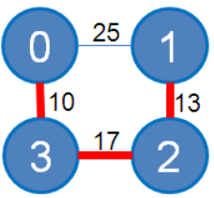
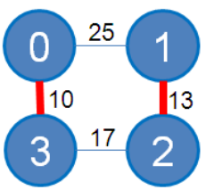
Minimum Spanning Forest
Problem example. You have two routers in your building, and you want to connect all devices by the less length wires.
Cost variations:
Less drilling walls.
Less visible places.
MST from two sources
MST

Slide 19
MSF – Nature Reserve
Task. Kattis – Nature Reserve – Link.
Read the task.

Slide 20
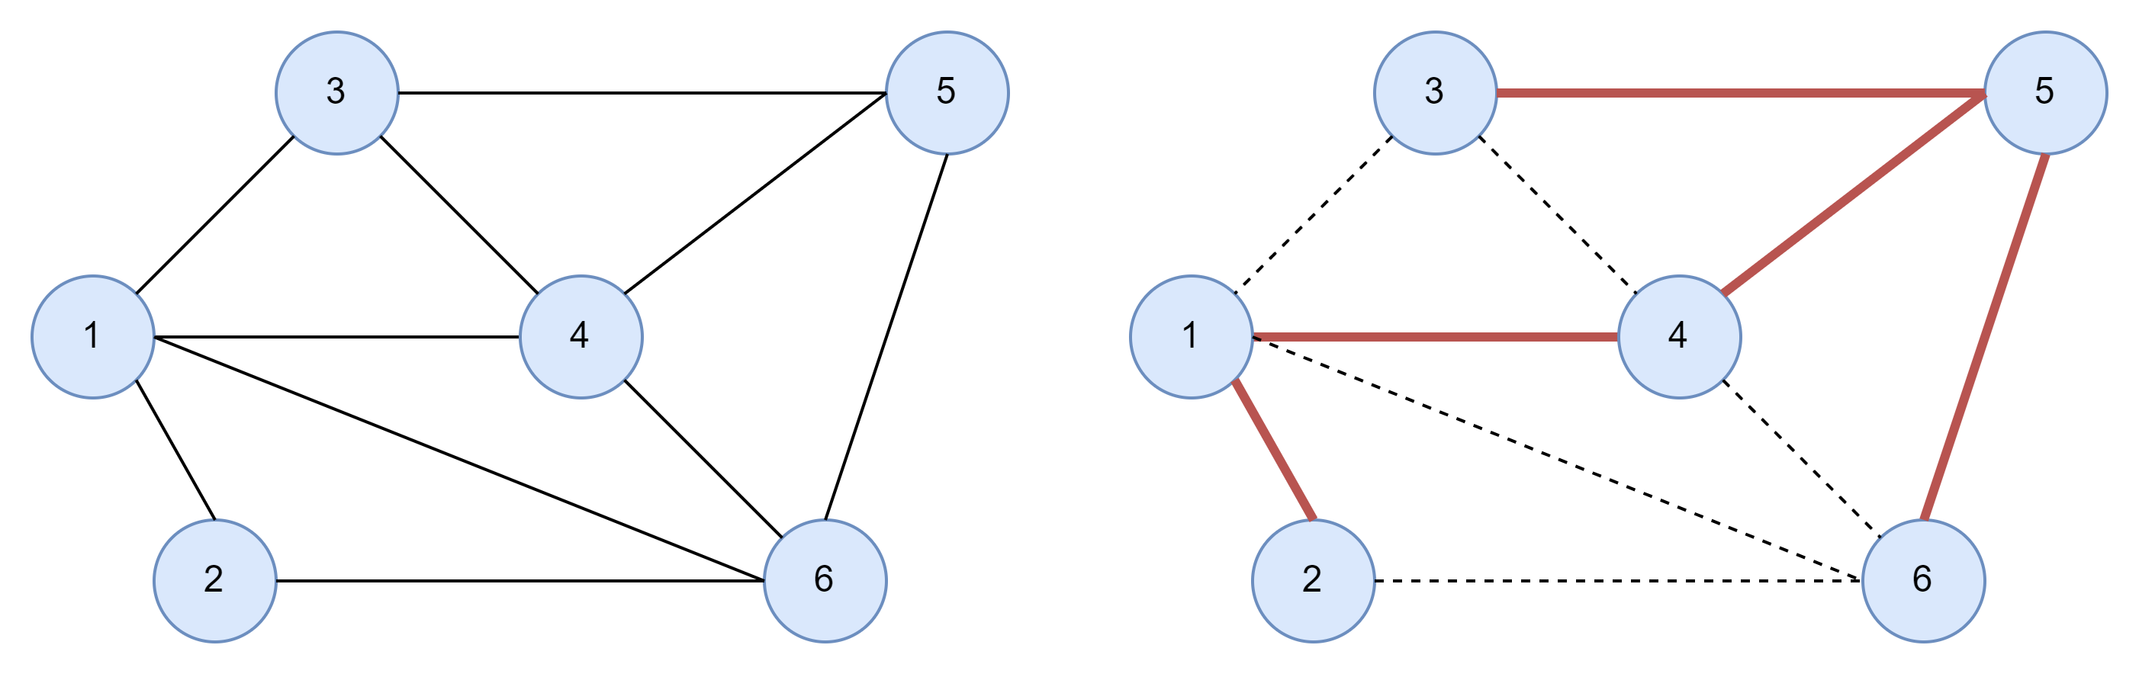
MSF – Nature Reserve
Task. Kattis – Nature Reserve – Link.
Original Graph
Minimum Spanning Tree
Classical Approach

Slide 21
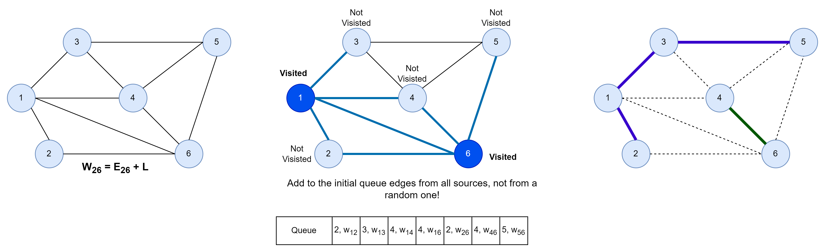
MSF – Nature Reserve
Task. Kattis – Nature Reserve – Link.

